Slide 1
2024 Spring RESAP Meeting
April 29-30, 2024
Area Administrator Meeting
Kansas City, MO – Westin Crown Plaza

Slide 2
Safety Message & Ground rules

Slide 3
Ground rules
Actively participate – everyone's voice is important
Seek to understand first – ask questions
Work towards the best solutions
  We seek a significant majority to move forward
Constantly look for incremental improvements
Seek strong relationships
Notes:
Stress the importance of searching for the best solution and not winning a debate…
Strong relationships is the key to influencing others and personal growth

Slide 4
VR Update / Rollout

Slide 5
General Review and Purpose
Purpose:
Simulate working conditions where line workers can perform work to help strengthen their understanding and use of safe work practices.
VR is not intended to ever take the place of hands-on training.

Slide 6
Lessons Learned and Utilization
In development, focus on the primary objectives of the experience
  De-emphasize the minor work details that can create distraction
  Test “sandbox” approach
  Smaller experiences that slices the work into smaller tasks may be viable approach in the future
Senior employees can be intimidated at first (don’t give up)
  Less senior employees are more confident
  Plan for ample practice time and utilization of tutorial
Utilization at a crew level with crew leader guiding discussion provides maximum benefit
  Utilization in a full safety meeting may reduce the benefit.

Slide 7
VR Update
Nathan Cannon

Slide 8
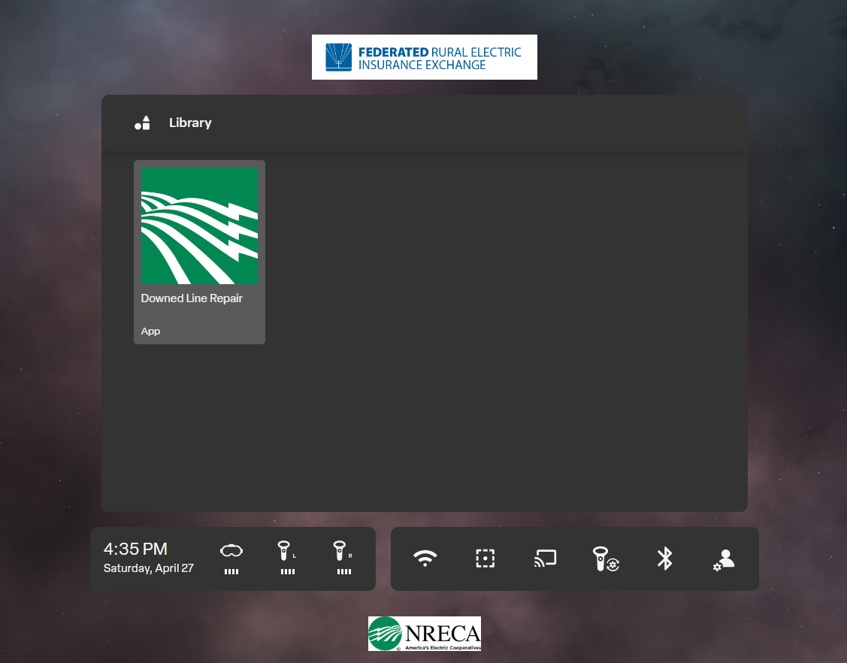
Management Software
Federated Rural and the NRECA have sponsored the purchase of VR Management Program for cooperatives and statewide associations in 2024.
With this software, headsets can be updated remotely with new experiences.
Support activities are streamlined with the ability to troubleshoot headsets remotely.

Slide 9

Ordering Additional Devices
Additional devices can be ordered through the NRECA.
Currently requests can be emailed to the NRECA safety department (Jasmyne or Ken).
  Once a request is received, an invoice will be sent from Electric Code for $650 / device.
Ensure the invoice address and shipping address for the device(s) are included in the request.
Notes:
Image credit: https://m.media-amazon.com/images/I/61Uy4GVp-UL.jpg

Slide 10
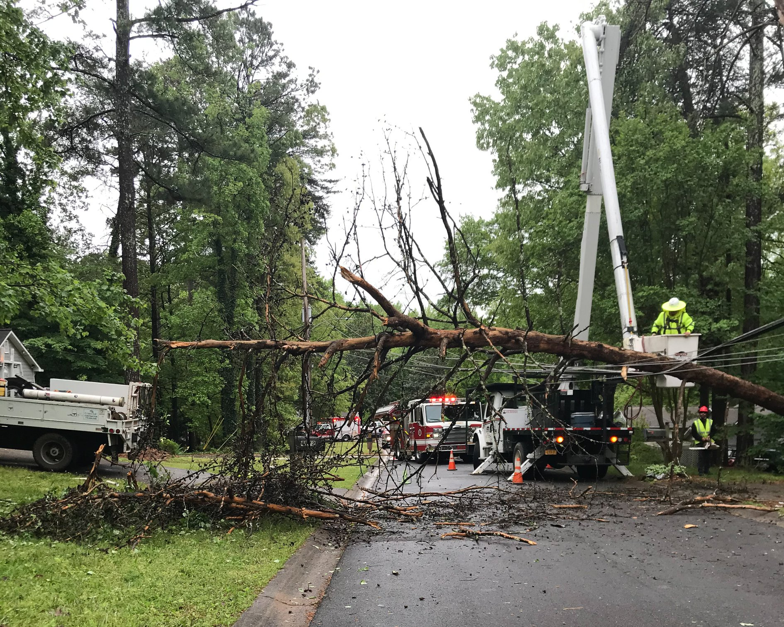
Down Line Repair Updates
Enhancements to Down Line Repair:
  Ability to skip repair procedure.
  Ability to ground at any location.
Headsets with management system are already updated.
Additional headsets will be updated in the coming few weeks.

Slide 11
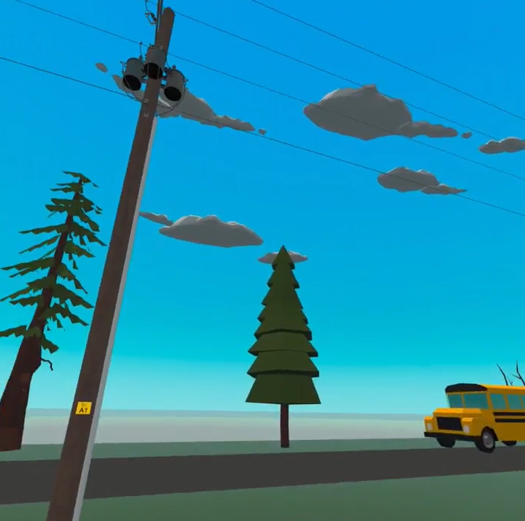
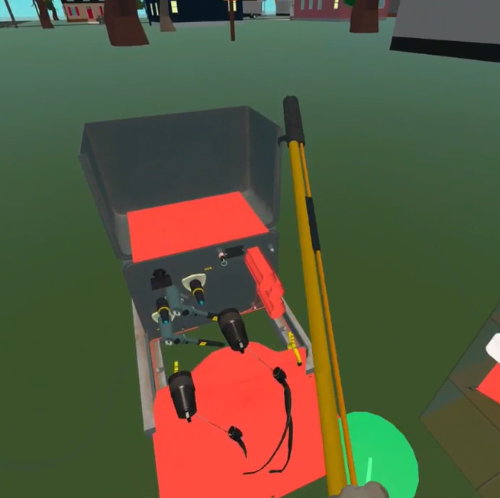
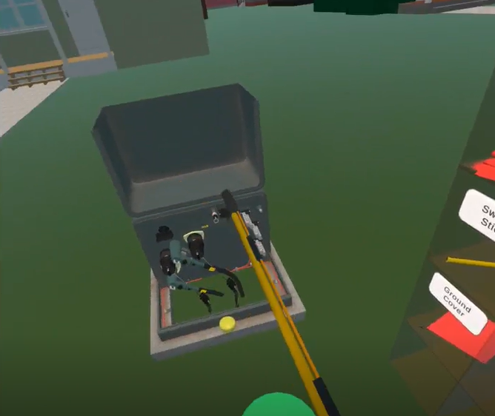
Future Experiences
Future experiences include:
  Underground Switching
  Coverup Training
Underground Switching allows the user to walk through a virtual neighborhood, identify the open point, and isolate.

Slide 12
Future Topics for Consideration

Slide 13
Future Topics for VR Development (from last meeting)
Topics identified multiple times (Spring Meeting):
  Regulator controls / bypassing
  URD switching / grounding
  URD fault locating and repair
  Tree removal off lines under tension
  Insulated Cover
Notes:
Advantages of sharing cost…

Slide 14
Review Existing Pike VR Topics for Potential Use
Handout

Slide 15
Commitment to Zero Contacts – Phase 2 Review & Update

Slide 16
Current Status
Phase 2 Sessions Completed or In-Progress
# Completed | # In-Progress
230 | 25
# of States
31

Slide 17
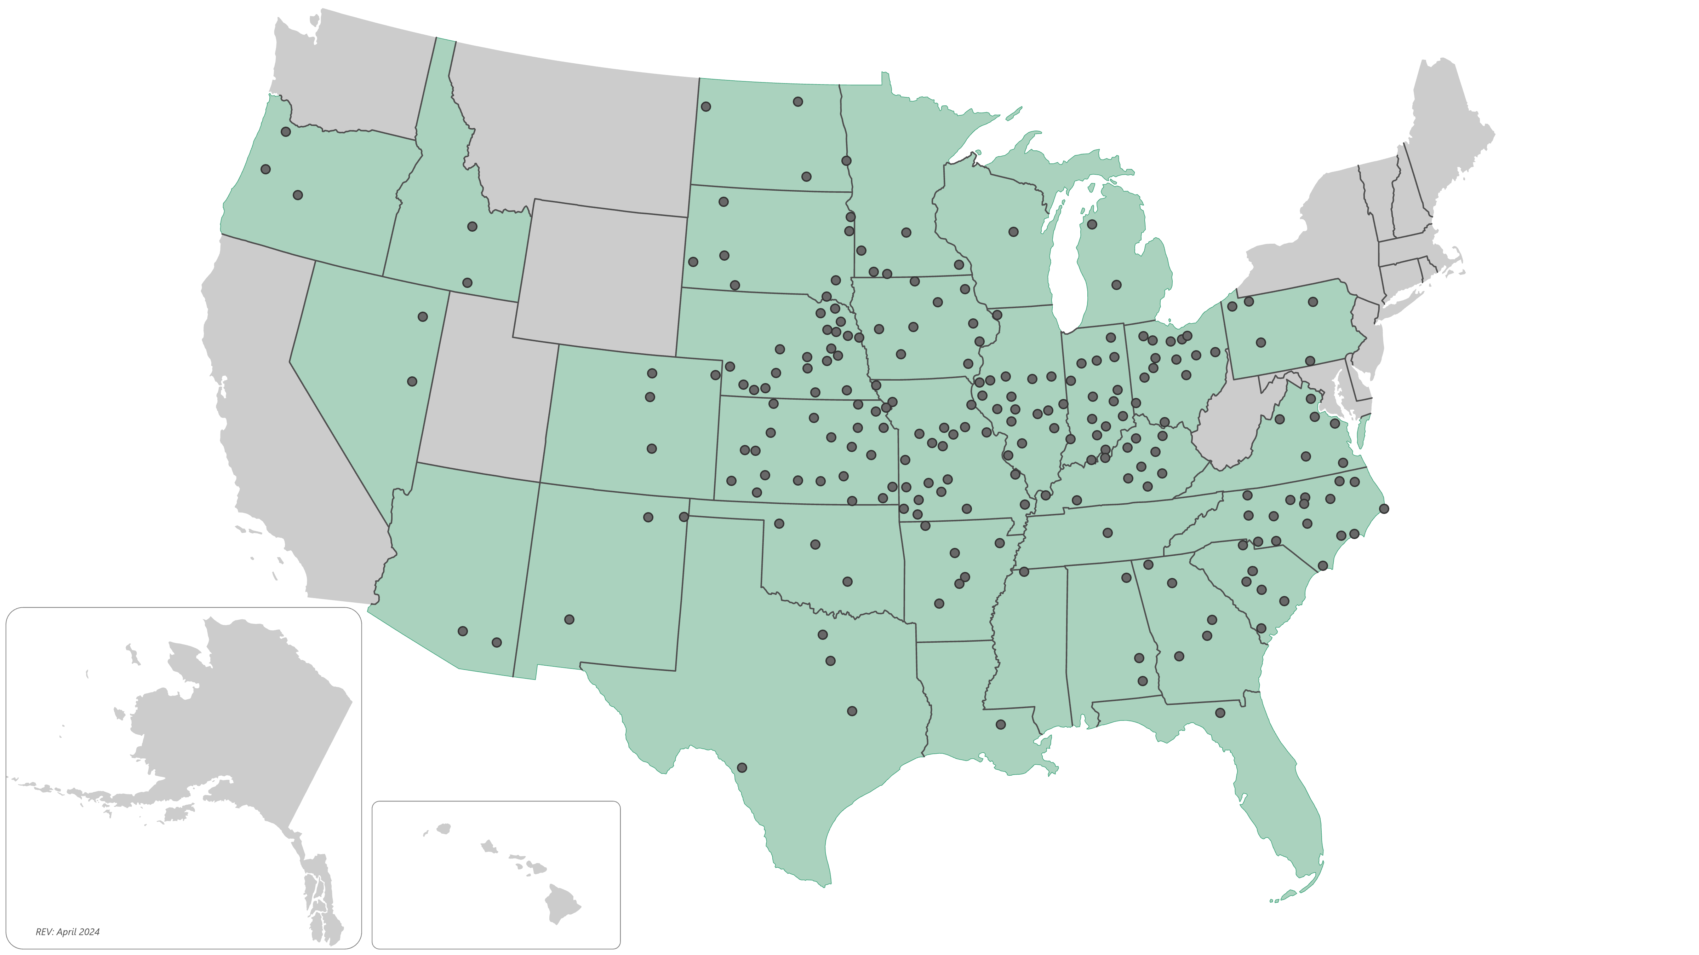
Phase 2 Sessions Completed as of 04/24/24

Slide 18
Results-to-date, Leading practices, Challenges

Slide 19
Summary of Surveys Conducted - results to date
For surveys conducted up from Apr. 2022 to Sept. 2023
Aggregate results for 150 co-ops
Based on responses from 3,007 co-op employees
Participation for co-ops in 27 states

Slide 20
Cover-up Practices
Q3. When performing energized work using the rubber glove method, what portion of the time are all differences of potential covered within reach or extended reach (or Minimum Approach Distance (MAD)) with appropriate insulated cover material, including primary and secondary neutrals, service lines, poles, cross arms, guy wires, etc.?

Slide 21
“Working it as if it was Hot”
Q5. Are you aware of work occurring on down-lines at your co-op using the “working it as if it was hot” practice (see definition)?
Definition for “working it as if it was hot”:
A practice of using gloves while on the ground to handle a downed conductor rather than establishing a visual open, tagging, testing for absence of voltage, and applying personal grounds at the worksite.

Slide 22
Qualified Observer
Q6. When energized work is performed, what portion of the time is a qualified observer assigned and in place during the work?

Slide 23
Effectiveness of Job Briefings
5-point scale: 1 = not very effective; 5 = very effective
Q7. Based on your experience, on a scale from 1 to 5, where 5 is very effective and 1 is not very effective, how effective are job briefings performed at your co-op?
47%

Slide 24
Conducting Job Site Observations
Q10. During normal working hours, how often does the line supervisor (the individual that supervises your crew leader) conduct job site observations on jobs you are working on?
Q11. After normal working hours, how often does the line supervisor (the individual that supervises your crew leader) conduct job site observations on jobs you are working on?

Slide 25
Feedback From Onsite Observations
Q12. When field work observations occur, what portion of the time do you receive feedback on safety performance?

Slide 26
Percent of Time PPE is Used When Working on Energized Lines or Equipment
Q2. Over the past 12 to 18 months, what portion of the time when work is performed on energized lines or equipment have you observed required PPE (see box) being used by affected employees?
Required insulating PPE:
Gloves
Sleeves
Di-electric footwear (if required)

Slide 27
G&T – Commitment to Zero Phase 2 Review
(EPRI)

Slide 28
SIF Exposure
SIF
Actual
SIF
Potential
SIF
Exposure
Life-Threatening Injury or illness
Life-Altering Injury or Illness
Fatality
Realistic possibility
Meets agreed upon SIF decision tree criteria
High-risk situation which could have resulted in a serious or fatal injury
Few “Actuals” + Many “Potentials” = SIF Exposure
| Pg. 28

Slide 29
SIF Data Collection Event Model
Close Calls
Safe Work Observations
SIF Exposure?
Reported Hazards
First Aid
Recordable Injury
Contractor Onsite Data?
| Pg. 29

Slide 30
Model Phase 2 Approach used in Distribution

Slide 31
Draft Implementation Process
Considerations and Next Steps:
Finalize employee surveys
Pilot the process in a few G&T’s
  Volunteer G&T’s
  Identify people interested in supporting the process and facilitation
Adjust process based on experience
Conduct facilitator training
Create centralized pool of process facilitators
Scheduling and participation process

Slide 32
Factors to Consider for Leadership Commitment Redesign
Ease of completion, straight forward and simple
CEO / GMs understand the rationale
Provides some flexibility for leaders to complete
Helps connect co-op leaders to the importance of safety and/or reflect on their personal involvement in safety.

Slide 33
Tuesday April 30, 2024 – 8am to 11:30pm
Looking Forward Ken
RESAP Program Review Bud/Ken
  Vision and Mission statement
  Current Situation
  Culture Safety Index
  G&T update
  Closing Conference / Crew Leaders
“CEO Safety Leadership Challenge” Bud
“You Made a Difference to that One” Ken
Summary and Next Steps All
End (11:30am)
Notes:
RESAP Culture Index
Broadband safety
Co-op safety performance at a statewide level

Slide 34
Looking Forward:
Observe, listen and identify areas of concern this group may have and make every effort to come alongside to assist. (Coach)
Educate-up on the “Why” of RESAP.
Focus on Foremen in regards to their influence and recast vision of RESAP with them.

Slide 35
Looking Forward:
Continue to motivate and encourage CEO’s to be actively engaged in their respective safety cultures.
Continue to encourage us to live out our CTZ.
Be a friend and confidant that you come to know is in the ditch with ya.
“Make it Personal, Make it Safe, Make it Home”

Slide 36
RESAP Program Review

Slide 37
Vision & Mission Statement

Slide 38

Jon Elkin
Fall 2022

Slide 39


Slide 40
2008 RESAP Mission Statement
RESAP Mission Statement
To establish and promote the highest quality safety standards, best practices, and behaviors of a high performing safety culture. We grade (accredit) Cooperatives on how well they meet these requirements, recognizing safety excellence.
Through this program, we provide the knowledge and guidance to influence safety improvement, reducing accidents, injuries, and losses.

Slide 41
2013 Vision & Mission
Our Vision
Engaged leaders and employees working to reduce risk of injury
Our Mission
Helping co-ops to continually evaluate safety performance and involve employees in creating a safer workplace

Slide 42
2015 RESAP Vision & Mission
Supporting Strategies
Vision & Mission
Our Vision
Working together to create a true culture of safety
Our Mission
Assist co-ops to continually evaluate and improve safety performance
Notes:
Leadership > drives culture > culture drives behavior

Slide 43
RESAP Leading Practices
What are the three primary goals of the RESAP program?
  Increase leadership engagement
  Increase employee involvement
  Strengthen a continuous improvement process (SIP)

Slide 44
2024 RESAP Vision & Mission
DRAFT
Vision:
To influence daily work practices to protect the safety and welfare of others.
Mission:
Build relationships in order to provide open feedback as suggestions to influence safety improvement.

Slide 45
Current Situation - RESAP Steps

Slide 46
RESAP Process Steps
1
2
3
4
5
Leadership Commitment
Safety Health Check (new)
Annual Performance Measures
Onsite Observation
Safety Improvement Plan
Once every 3 years
Once every 3 years
Annually
Once every 3 years
Annually
Draws leaders' attention – helps assess they’re level of engagement
Promotes internal self-assessment – assures responsibilities are clear
Provides benchmarking & overview of performance trends
Honest feedback for improvement
Structured approach for continuous improvement

Slide 47
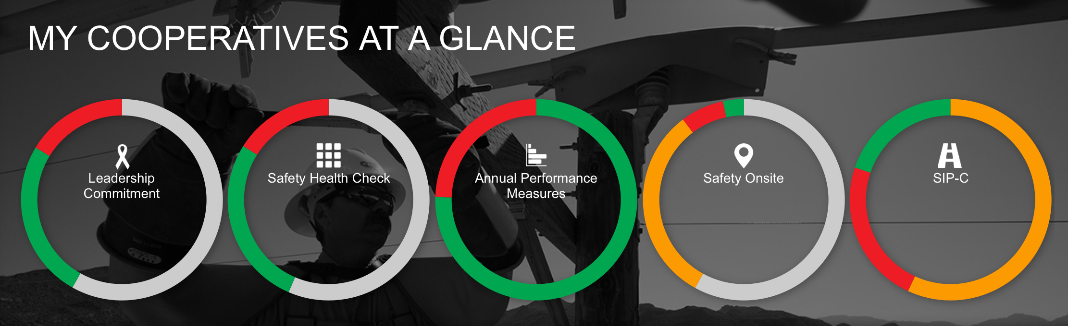
Dashboard Status as of 04-24-24

Slide 48
Safety Culture Index
A Leading Indicator of Safety Improvement

Slide 49
Why measure safety culture?
Strong
Studies show a relationship between Strength of Culture and Injury Rates!
Measured Strength of Safety Culture
Weak
Low
High
Injury Rates

Slide 50
Path for Improved Culture and Organizational Results
Organizational Culture
Team Chemistry
Organization Attributes
Mutual trust
Organizational commitment
Openness to change
Teamwork
Communication and cooperation
High Performance Results
Leadership Leading Practices
Lower injury rates
Lower turnover
Improved productivity
Higher service quality
Increased ownership
Credibility
Action Oriented
Feedback and Recognition
Accountability
Vision
Communication
Collaboration
Engagement

Slide 51
Overview of the Safety Culture Index (SCI)
Rapid single-point measure of safety culture
Based on a 13-statement survey that measures agreement levels
Score is mapped against one of four assessment ranges
Establishes a baseline assessment for continuous improvement
Brings another dimension to a safety improvement plan

Slide 52
Safety Culture Index
Outside: 71
Inside: 86
ABC EMC : 79
ABC EMC:

Slide 53
Culture Index Statements
1-5 scale, 1 = Strongly Disagree 5 = Strongly Agree
53
Example

Slide 54
Culture Index Statements
1-5 scale, 1 = Strongly Disagree 5 = Strongly Agree
54
Example

Slide 55
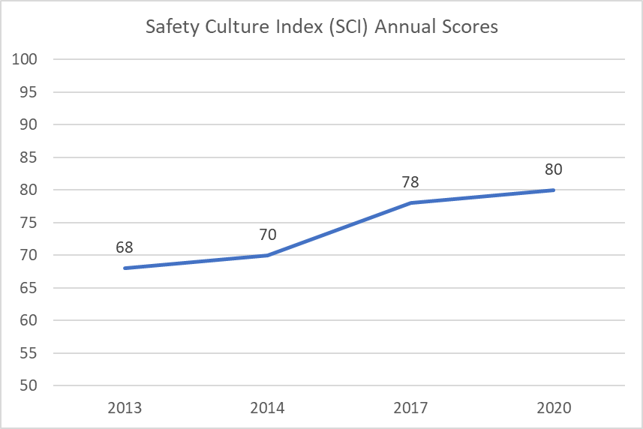
SCI Trend Over Time
Example

Slide 56
G&T – RESAP Onsite Survey Update

Slide 57
G&T Onsite Survey Updated and Combined
Generation Onsite Survey
Power Delivery Onsite Survey
G&T Onsite Survey
57

Slide 58
Generation and Transmission Onsite Observation Survey 2024 Section 1: Safety Organization and Safety Improvement Plan (G) - 3 Section 2: Safety Administration; Programs, Procedures, Rules, and PPE (G) - 5 Section 3: Working Safe Processes and Practices (G) 16 Section 4: Facilities Physical Conditions (G) - 19 Section 5: Facilities Safety Equipment (G) 24 Section 6: Administrative Buildings, Offices (G) - 26 Section 7: Warehouse and Storage Facilities (G) 28 Section 8: Maintenance Facilities, Shops (G) - 31 Section 9: Generation Specific ­ General Safety Items (G) - 34 Section 10: Turbine, Generator, and Boiler Buildings (G) - 42 Section 11: Precipitator, Baghouse, Ash Handling Systems (G) - 44 Section 12: Selective Catalytic Reduction(SCRs), Selective Noncatalytic Reduction(SNCRs),Anhydrous & Aqueous Ammonia System. (G) - 46 Section 13: Wet Scrubbers & Reagent Prep Plant and Dry Scrubbers & Hydrated Lime Systems (G) - 48 Section 14: Water Treatment and Water Conditioning Facilities (G) 50 Section 15: Material Handling Systems: Coal and Other Bulk Materials (G) - 52 Section 16: Barge Operations and Maintenance (G) 55 Section 17: Railcar Unloading Operations (G) - 57 Section 18: Water Intake and Discharge Facilities (G) - 59 Section 19: Laboratory (G) - 61 Section 20: Substations and Switchyards (G) - 63 Section 21: Mobile Equipment Maintenance (G) - 65 Section 22: Motor Veh. ≤ 10,000 lbs. GVWR & Comm. Motor Veh. (CMV) < 10,000 lbs. GVWR for Highway Use (G) - 67 Section 23: Backhoes, Cranes, Scrappers, Dozers, etc. (G) - 70 Section 24: Misc. Vehicles (ATV’s/UTV’s, Snow Equipment, Aerial Lifts, Watercraft, Trailers, etc.) (G) - 72 Section 25: Combustion Turbines (G) - 74
Updated Generation Index

Slide 59
Generation and Transmission Onsite Observation Survey 2024 Section 26: Hydro Electric Plants (G) - 76 Section 27: Solar Photovoltaic (PV) Sites (G) - 78 Section 28: Wind Turbine Generator Sites (G) - 80 Section 29: Battery Energy Storage Systems (BESS) (G) - 83 Section 30: Employee Interview Common Questions (G) - 87 Section 31: Safety Program Elements & Safety Improvement Plan (T/D) - 90 Section 32: Common Facility Safety Equipment ­ Facilities & Vehicles (T/D) - 93 Section 33: Warehouse and Covered Storage (T/D) - 101 Section 34: Maintenance Facilities (T/D) - 103 Section 35: Environmental / Hazardous Materials (T/D) - 112 Section 36: Pole Yard and Outside Storage (T/D) - 117 Section 37: Administration and Other Office Areas (T/D) - 119 Section 38: General Vehicles (Under 10,000 lbs. GVWR) (T/D) - 122 Section 39: Diggers, Buckets, etc. (Over 10,000 lbs. GVWR) (T/D) - 124 Section 40: Misc. Vehicle (Trailers, Backhoes, etc.) (T/D) - 130 Section 41: Truck and Personal Tools (T/D) - 135 Section 42: Head, Eye, Face, Hearing, Foot, Hand, etc. PPE (T/D) - 139 Section 43: Insulating Gloves, Sleeves, and Cover­up (T/D) - 144 Section 44: Arc Rated Clothing / Systems + Fall Protection (T/D) - 147 Section 45: Crew Visits (T/D) - 151 Section 46: Substations (T/D) - 157 Section 47: Overhead & Underground Lines, Equipment, etc. (T/D) - 162 Section 48: Solar Generation (T/D) - 165 Section 49: Wind Generation Sites (T/D) - 168 Section 50: Battery Energy Storage Systems (BESS) (T/D) - 172 Section 51: Broadband Operations (T/D) -177
Updated Generation Index (continued)

Slide 60
Safety Health Check Updated

Slide 61
Closing Conference / Crew Leaders

Slide 62
Key Points to Consider:
Communication challenges still exist regarding the true purpose of RESAP.
Adding crew leaders to the closing conference helps strengthen ownership.
Conducting a professional closing conference in RESAP is a key step in the process.
Emphasizing positives first is important.
Summarizing the most important improvements opportunities in a clear simple way for inclusion into a safety improvement plan adds great value.

Slide 63
CEO Safety Leadership Challenge

Slide 64





Three Levels of Safety Leadership Engagement
20%
74%
6%
Actively Engaged
Limited Engagement
Little to No Engagement

Slide 65
CEO Safety Leadership Challenge – Summary Overview
Purpose:
Increase greater CEO leadership attention to safety.
Overview:
Challenge CEOs to raise the bar on their current leadership engagement.
Establish strong visible criteria for CEO leading practices in safety leadership.
Small unbiased evaluation team performs rapid assessment (one to two days onsite) of safety management system at four-levels –
  Senior staff > middle management > frontline supervision > line employees

Slide 66
CEO Safety Leadership Challenge – Summary Overview
Model similar to:
OSHA VPP Star program
National Safety Counsel – “CEOs - who get it”, recognition
Considerations:
Create development task team
Create CEO advisory group (one from each region?)
Application for evaluation
Strong evaluation criteria – process is meant to be challenging

Slide 67
CEO Safety Leadership Challenge – Summary Overview
Possible evaluation areas:
Safety management structure and/or system
Effectiveness of Safety Improvement Plan
Expectations established for safety performance
Hazard identification system with follow up
Front-line employee engagement in safety
Safety coaching by front-line supervision
Safety integrated into core business processes
Safety recognition process

Slide 68
“You Made a Difference to that One”

Slide 69
Fall RESAP Meeting
November 12 – 13th, 2024
Oklahoma Statewide Association - Oklahoma City, OK
To be confirmed

Slide 70
Ken’s Contact Information:
Email: ken.macken@nreca.coop
Cell Number: (918) 868-7588

