Slide 1
PAC Rebrand

Slide 2
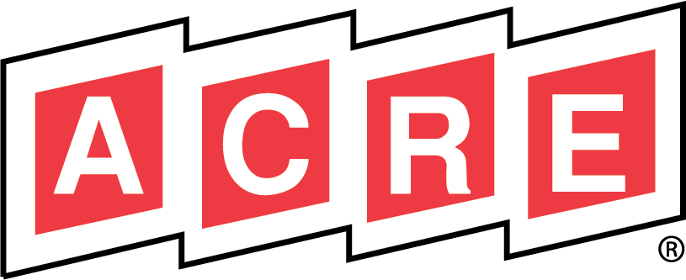
That Was Then
Notes:
NRECA established the Action Committee for Rural Electrification 56 years ago as it’s political action committee (PAC) supporting candidates who speak for the interests of electric co-ops and their consumer-members. The name of the PAC was then, as it is now, commonly referred to by the acronym, “ACRE.”
In the early days of ACRE, when acronyms were less prevalent than they are today, the connection between ACRE and its mission was understood by policymakers.
However, today, its intrinsic relationship to electric co-ops is no longer obvious.

Slide 3
Changing Course
Notes:
As NRECA continues its advocacy on behalf of the membership, it is critical that all advocacy programs strongly connect back to the political identity of NRECA and America’s electric cooperatives.
With the ACRE brand so disconnected from the NRECA brand, it was time to consider a name change.

Slide 4
Research: What We Heard
Renaming and rebranding ACRE will:
Policymakers
Donors
Make connections between donations, electric cooperatives and NRECA more clear.
Reflect their own identities and experiences with NRECA and electric co-ops.
Policymakers & Donors
Eliminate confusion about the PAC’s association(s) and objective(s).
Notes:
NRECA’s first step was getting feedback from the people who were closest to ACRE – donors and the policymakers. They conducted interviews and focus groups with D.C. policymakers and PAC donors to assess their attitudes towards the ACRE brand. This slide reflects the feedback received from these audiences when asked what renaming and rebranding ACRE would do for them.
The research revealed that both internal and external stakeholders were in clear agreement that NRECA should rename and rebrand ACRE in a way that made the PAC’s identity more strongly and explicitly connected to America’s electric cooperatives.

Slide 5
This Is Now
Notes:
And so, without further ado, here is the future of NRECA’s PAC: America’s Electric Cooperatives PAC.

Slide 6
Maximizing Our Advocacy Impact
Clarity, Credit and Unity
Notes:
To enhance recognition with NRECA’s brand, the new name uses NRECA’s brand tagline and signature “green ball” design. It also no longer shortens the PAC identity to an acronym which will keep “electric cooperatives” top of mind upon first glance in all mediums. This new name and visual identity will enable NRECA to advance the interests of its members and donors by clearly identifying where PAC contributions come from and aligning it to NRECA’s brand and reputation which is well-known and well-respected among policymakers.
The expectation is that the new brand, with its connection to electric cooperatives and NRECA, will strengthen and unify NRECA’s advocacy efforts across the board and increase the value of donor contributions.
For NRECA, this shift is an opportunity to energize current donors and expand outreach to potential new donors through a PAC communications strategy in 2023.

Slide 7
What You Need to Know
Jan./Feb. Prepare the co-op for change
March
Launch
New Materials Available
April-Dec.
Stay Engaged
2023
Notes:
This will be a year-long transition. NRECA is leveraging 2023 events to both preview the new name and identity to key member audiences at events like CEOs at CEO Close-Up and Directors Conferences and then at PowerXchange, announce that transition has taken place and the PAC is now known as America’s Electric Cooperatives PAC. At this time, all materials will be updated to reflect the new brand. While the new name and brand will go into effect in March, below are a few ways your co-op can prepare for the transition now.
Talk to your staff and prepare the co-op for any necessary changes
Review FAQ sheet
Plan as usual for your annual PAC solicitations
Join webinars hosted by NRECA
Makes changes to PAC check(s) payee name
Update payroll deduction and bill addition label
Make inventory changes for the website and PAC related materials
When we launch on March 6, 2023, you can
Implement updates and changes as needed
Download new tools and resources found in the PAC Recruitment Toolkit on cooperative.com
Hand out new lapel pins
Throughout the year, you can stay engaged by
Monitoring the progress of all updates
Joining webinars hosted by NRECA providing updates on the rebrand and transition
Looking for opportunities to engage eligible staff, directors and consumer-members
As a note, NRECA will be able to process all PAC contributions addressed to ACRE or America’s Electric Cooperatives PAC throughout the entire transition period.

Slide 8
Strengthening & Unifying NRECA’s Advocacy
Notes:
NRECA is committed to continuously strengthening its advocacy efforts on behalf of its members. And now, with the PAC aligned with NRECA’s well-known and highly respected identity, electric cooperatives will realize a stronger reputational impact on federal policymakers. NRECA is excited to work with electric co-ops to implement the new PAC brand AND to engage eligible employees, co-op directors and consumer-members to join the PAC.

