Slide 1
Grant Writing Support Program Webinar
How to take advantage of NRECA’s Grant Writing Support Program.
When to request support.
What to expect when requesting support.

Slide 2
Contact Technical Support
For immediate help, call Freestone at (866) 702-3278 or +1 (770) 805-6292.

Slide 3
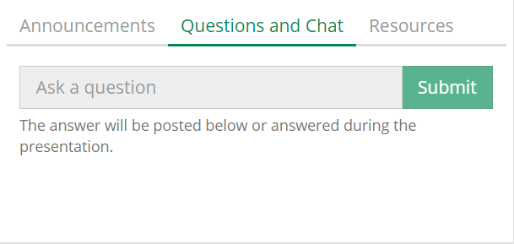
Submit Your Questions
Step 1: Type in your question.
Step 2: Click the Submit button.

Slide 4
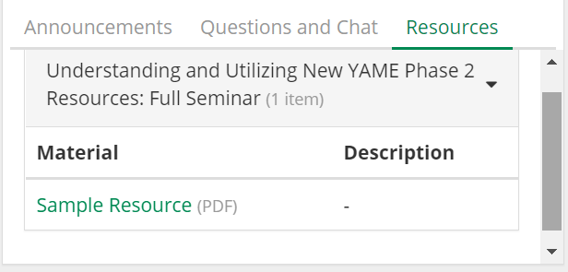
Download Today’s Files
1. Click here in the Resources box to open the presentation slides or handout.
2. Click on an icon to print or save the file.

Slide 5
Agenda
1
HELPFUL LINKS
4
PORTAL QUESTIONNAIRE
2
WRITING SERVICES PRELIMINARY PREP
5
FAQs
3
PROPOSAL PROCESS

Slide 6
Helpful Links
Portal
Infrastructure Hub
Guidebook
How NRECA members request writing support
Information + guidance:
Current funding opportunities
How to get started:
Preparing for funding opportunities
Link
Link
Link

Slide 7
Writing Services: Preliminary Prep
Obtain Unique Identifier (UEI) (formerly DUNS)
Identify Funding Opportunity (FOA) Number
Preliminary Prep
Review FOA Eligibility Criteria / Partnerships
Collect Data
Request Writing Assistance through the Portal

Slide 8
Writing Services: Preliminary Prep
Obtain Unique Identifier (UEI) (formerly DUNS)
Preliminary Prep
Register on Grants.gov and SAM.gov
Receive UEI and CAGE Code (approximately 44 days)

Slide 9
Writing Services: Preliminary Prep
Preliminary Prep
Identify Funding Opportunity (FOA) Number
Check agency websites, attend webinars, sign up for mailing lists
Open or nearly-open opportunity
Read through full FOA and understand the requirements
Concept paper or full proposal?
Preferably ~6-8 weeks of lead time

Slide 10
Writing Services: Preliminary Prep
Preliminary Prep
Review FOA Eligibility Criteria / Partnerships
Double and triple check eligibility requirements
Electric utility, states, tribes, municipality, for-profit, or non-profit?
Partnering (3-6 weeks, ideally)

Slide 11
Writing Services: Preliminary Prep
Develop a Diversity, Equity and Inclusion (DEI) Plan tailored to project (See Guidebook p. 18)
Develop a Cybersecurity Plan tailored to project (See Guidebook, p. 18)
Create a Project Plan (See Guidebook, p. 17)
Preliminary Prep
Collect Data

Slide 12
\Writing Services: Preliminary Prep
Preliminary Prep
Include FOA information (any links, press releases, or opportunity announcement)
Fulfill the Pre-Eligibility checklist!
Request Writing Assistance through the Portal

Slide 13
Proposal Process
Submit Request
Screening Call
Meet Writer
Kick-off
Submission
Preliminary prep work
Submit request for writing support through Portal
CSL reviews request (3-5 business days)
Co-op Readiness Verification
FOA review
Determine next steps
Co-op + Writer introduction
Funding & project overview
Terms of collaboration
Proposal design workshop
Sharing platform
Milestones
Roles & responsibility
Pre- submission review (2 days to deadline)
Submit
Lessons learned
Surveys
CSL Grant
Writer Pairing
Co-op + Writer Contract
Quality
Control

Slide 14
Portal Questionnaire
1
Cooperative Name
2
Cooperative State
3
RUS Number
4
Which IIJA Program are you pursuing or considering pursuing?

Slide 15
Portal Questionnaire
What is the number/name of the solicitation (i.e. Funding Opportunity Announcement (FOA), Request for Proposal (RFP) or Notice of Funding Opportunity (NOFO) that you are interested in applying to?
5
Please provide any link(s) to the source of the information you have found on this specific funding opportunity that your cooperative is interested in.
6
7
What is the due date for your grant application in the announcement?

Slide 16
Portal Questionnaire
8
Do you know your CAGE code?
Have you collected, or do you plan to collect, readily available demographic data for your cooperative or territory where the project will happen?
9
10
Do you plan to team with other organizations to make your grant application?

Slide 17
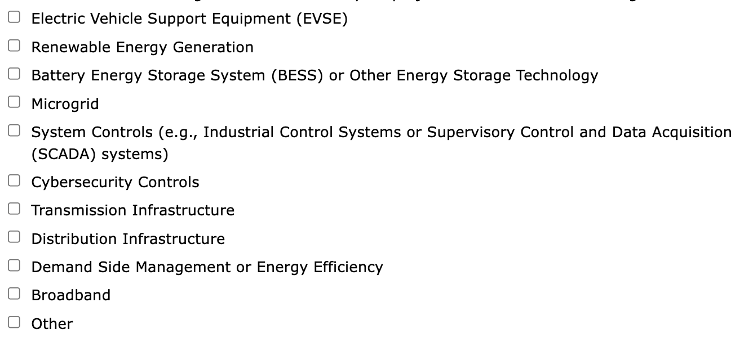
Portal Questionnaire
11
Please check the following boxes to indicate if your project will include the technologies listed below.

Slide 18
Portal Questionnaire
The FOA may require a Diversity, Equity and Inclusion (DEI) Plan that is project-specific and outlines how the project outcomes will benefit underserved communities through participation. Does your organization have an existing DEI plan?
12
13
Tell us more. Is there anything else we should know about your application?
Notes:
#12: Read the FOA, have your plan, then tailor the plan for the project. Don’t just upload your generic organizational DEI plan.

Slide 19
FAQs
Can you help with research, concept development, technical assistance, or grant management?
Sometimes, and only when paired with funding opportunity application writing assistance. Once application has been made through the portal, CSL can look for writers that may provide other services in addition to writing assistance services.
CSL cannot guarantee matches to all other services (outside of writing) required by the cooperative. Cooperatives seeking significant research, concept development, technical assistance, or grant management services should pursue these independent of this writing assistance process.

Slide 20
FAQs
Can you share the name of other co-ops that have submitted through the Portal in case we want to partner with them?
No. In the interest of privacy, CSL and NRECA will not be sharing the names of cooperatives that submit requests for writing assistance.

Slide 21
FAQs
How do we construct a Diversity, Equity and Inclusion (DEI) Plan?
Cooperatives should begin by reviewing NRECA DEI guidance and other common federal data requirements.
Many funding opportunities, particularly from the Department of Energy, will require unique DEI Plans specific to a project concept. Cooperatives should have baseline organizational and territory DEI data (e.g., DEI Statement, territory demographics, standing DEI goals) ready to include in that Plan. Then, cooperatives add concept-specific DEI data and impacts as needed.

Slide 22
FAQs
What is the pay structure and how are the costs incurred?
In the Co-op-Writer Contract you will see:
$1,500 Converge support fee
$500 NRECA administration fee
Writer fees - examples:
Hourly ($75 - $120 per hour)
Flat fee ($250 - $20,000)
Retainer ($1,000 for 10 hours)

Slide 23
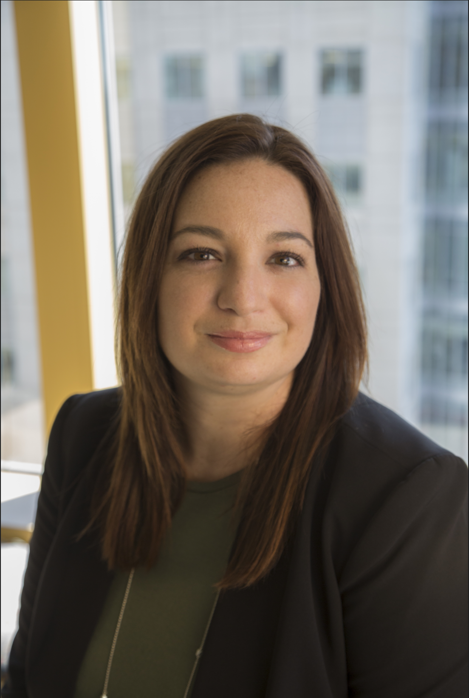
Contact
LAUREN KHAIR
Director, Business Transformation
lauren.khair@nreca.coop

